Slide 1
FRACTION OPERATIONS
Start

Slide 2
Be careful! There is an impostor among us trying to sabotage our ship!
You need to complete all of the crewmate tasks by clicking through each slide to solve the problems. You got this!
Click here

Slide 3
Click here

Slide 4
The impostor just sabotaged the communications on this ship!
Click here

Slide 5
Purple, weren’t you close to electrical?
No, I was at the cafeteria with green!
That’s right!
I wonder where were you red?
Yellow probably did it!
Click here

Slide 6
Click on communications to solve this task!

Slide 7
Communications
Subtract these fractions and click on the right answer.
-
Task 1

Slide 8
You did it! But while you were solving the task the impostor went to another place on this ship!
Click here

Slide 9
Oops! Keep trying!
Click here

Slide 10
I’m locked in the low engine section!
I can’t get out of here!
Are you sure you can’t get out?
We need to fix this!
I won’t even try to get out!
Click here

Slide 11
The doors won’t open! The impostor locked so many crewmates in different rooms.
Solve the next task to unlock them!
Click here

Slide 12
Unlocking the doors
+
Task 2

Slide 13
Thanks to you, your crewmates can walk freely in the ship!
Click here

Slide 14
Oops! Keep trying!
Click here

Slide 15
Oh no! Everything went black! Your crewmates have limited vision. They can only see a small area around them.
Click here

Slide 16
Really?
How am I supposed to walk like this?
I’m looking at red and he seems to have perfect sight!
What do you mean green?
No, I can’t see a thing!
Click here

Slide 17
Click on electrical to bring the electricity back!

Slide 18
Electrical
.
20 = 15
True
False
Task 3

Slide 19
You did it! Now that the electricity is back, call for an emergency meeting! One of the crewmates is looking real SUS!
Click here

Slide 20
Oops! Keep trying!
Click here

Slide 21
Enough, where were you guys?
Red and I were fixing the electricity while
you were acting all SUS!
There must be a way to access the security camera and find out who the impostor is.
Yellow, why are you acting like the boss?
Is there something you want to tell us yellow?
Click here

Slide 22
As green mentioned, there is a way to have access to the security cameras and show others who the impostor is! The only thing that you need to do is to solve these series of tasks!
Click here

Slide 23
Multiply and click on the right answer..
Task 4

Slide 24
Way to go! You are one step closer to proving who the impostor is.
Click here

Slide 25
Oops! Keep trying!
Click here

Slide 26
True or False.
True
False
Task 5

Slide 27
Oh yeah! You are one step closer to proving who the impostor is.
Click here

Slide 28
We are so close now!
I don’t think that we will have access to those cameras.
I’m telling you, this is what we have to do!
I think yellow is the impostor!
We are wasting our time! Yellow is the impostor!!!!
Click here

Slide 29
Oops! Keep trying!
Click here

Slide 30
-
Task 6

Slide 31
Come on! You can do it! You are one step closer to proving who the impostor is.
Click here

Slide 32
Oops! Keep trying!
Click here

Slide 33
True or False.
÷
=
True
False
Task 7

Slide 34
Hooray! You are one step closer to proving who the impostor is.
Click here

Slide 35
Oops! Keep trying!
Click here

Slide 36
Add and click on the right answer (the simplest form).
Task 8

Slide 37
You are becoming a pro! You are one step closer to proving who the impostor is.
Click here

Slide 38
Oops! Keep trying!
Click here

Slide 39
True or False.
True
False
Task 9

Slide 40
Yeaaahh! You are one step closer to prove who the impostor is.
Click here

Slide 41
Oops! Keep trying!
Click here

Slide 42
.
Task 10

Slide 43
You did it!
Click here

Slide 44
Oops! Keep trying!
Click here

Slide 45
Click here
Access Granted

Slide 46
I wonder why do you think I’m the impostor?
Yes!!! We did it!
I told you, the cameras won’t lie!
We will finally know who the impostor is!
There’s something I need to tell you…
Click here

Slide 47
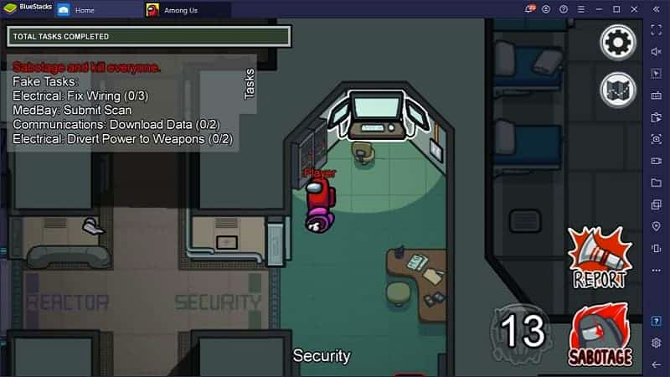
The red player is the impostor! Now that you solved those tasks you finally got access to the security cameras.
Click here

Slide 48
You did such an amazing job! Now you are ready to prove to the others who the impostor is!
VICTORY

