Slide 1
Look at photos on the following slides of famous family members.
Identify similar characteristics between the children and the parents.

Slide 2
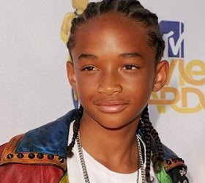
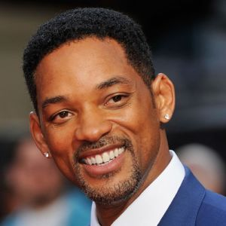
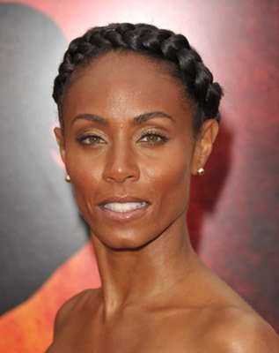
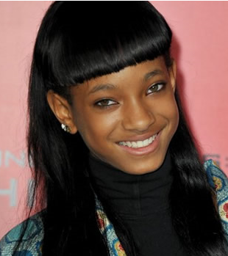

Slide 3
Think of a characteristic that you share with a family member.
Think of a characteristic that you have that none of your family members share.

Slide 4
Based on our opening activity, we know that we have characteristics of our parents, yet we are unique individuals. Why is this?
The answer is in the understanding of Heredity.

Slide 5
Heredity is the passing of traits from parents to offspring.
Genetics is the study of heredity.

Slide 6
Essential Question: How are genes, chromosomes, and heredity “related” to one another?
Standards:
S7L3a. Explain the role of genes and chromosomes in the process of inheriting a specific trait.

Slide 7
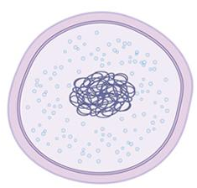
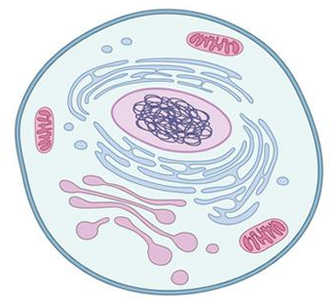
What’s the difference between these two cells?
Prokaryote
Eukaryote
Genetic Material
Genetic Material

Slide 8
What’s the purpose of the genetic material?
Prokaryote
Eukaryote
Genetic Material
Genetic Material

Slide 9
So far, we have discussed genetic material in the nucleus of a cell that makes you unique. Now, we can give the genetic material a name…
Genetic Material
DNA

Slide 10
DNA stands for…
DeoxyriboNucleic Acid
Genetic Material: DNA

Slide 11
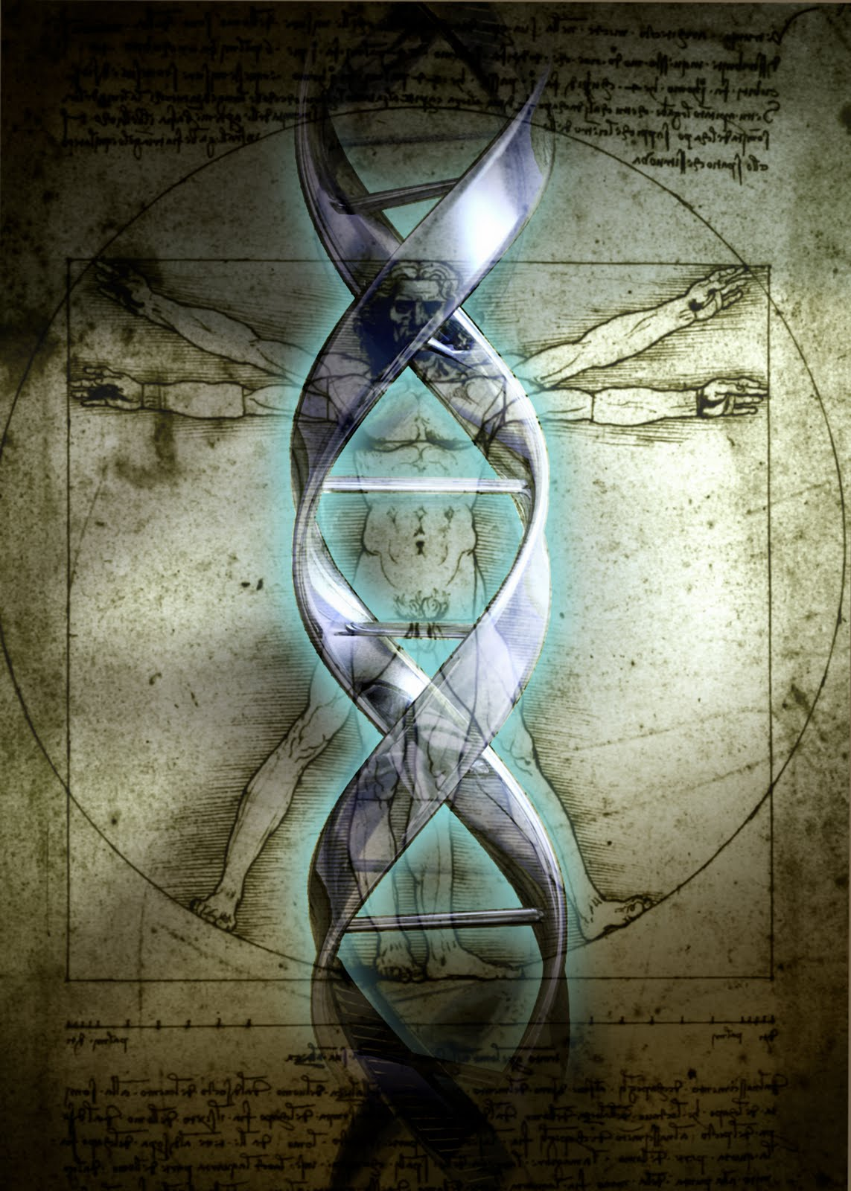
DNA is often referred to as a blueprint because it contains the instructions needed for an organism to grow, maintain itself, and reproduce.

Slide 12
Genetic material (DNA) makes you an individual with a unique combination of characteristics. These characteristics are also known as Traits.
Genetic Material
Turn to a seat partner and describe a few Traits that make you different from others.

Slide 13
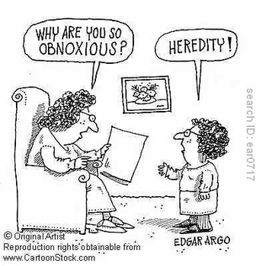

Slide 14
Inherited Traits
Many of your traits may resemble those your parents have, including your hair color, eye color, and blood type. These characteristics are called inherited traits.
Some traits are acquired, not inherited. Which means the trait is developed during your life.
Some traits are both inherited and acquired. For example, skin color has both an inherited component and an environmental one.

Slide 15
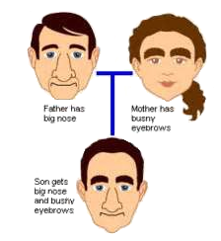
Inherited Traits

Slide 16
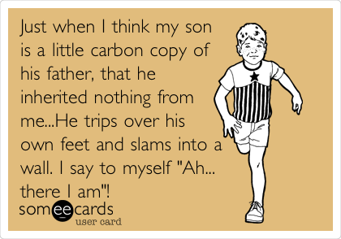

Slide 17
Inherited Traits
If a mother works out as a body builder for many years, will her offspring inherit strong muscles? Why or Why Not?
If a father speaks several languages fluently, will his children be able to understand what he is saying in different languages? Why or Why Not?

Slide 18
Inherited Traits
Turn to a seat partner and share a trait that you inherited and a trait that you may have just acquired.

Slide 19
You inherit traits through sexual reproduction.
During sexual reproduction, a cell containing genetic material (DNA) from the mother and a cell containing genetic material (DNA) from the father combine into a completely new cell, which becomes the offspring.

Slide 20
Inherited traits are controlled by the structures, materials, and processes you learned about in the previous unit.
Which structures and processes of the cell do you think are responsible for the inheritance of traits?

Slide 21
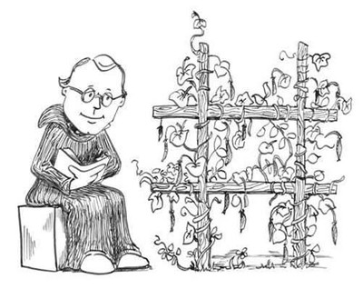
Gregor Mendel discovered that there are patterns to inheritance. He did this by studying pea plants while living at a monastery.

Slide 22
Through Mendel’s discoveries, we found out that inherited traits (characteristics) are determined by genes.

Slide 23
Overview of Mendel’s Experiment
https://www.youtube.com/watch?v=Mehz7tCxjSE

Slide 24
Genes, Chromosomes, Heredity, and DNA, what’s the difference?
Notes:
Transition slide

Slide 25
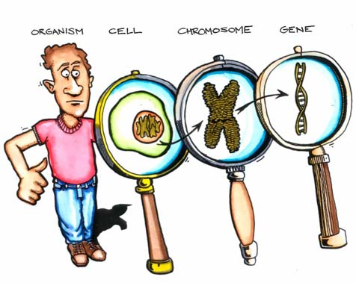
Let’s Look Deeper…

Slide 26
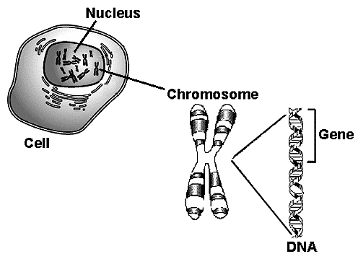
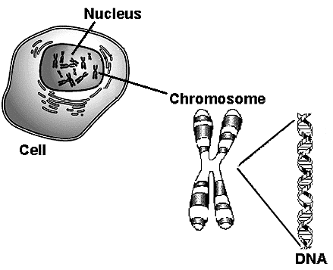
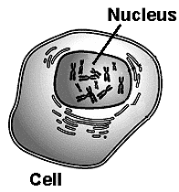
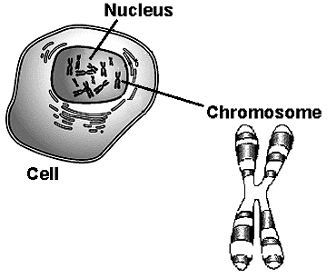
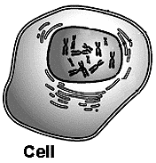
A Eukaryotic cell has a Nucleus that contains genetic material.
A Chromosome is the structure that holds the genetic material (DNA).
A Gene is a section of DNA that provides instructions for specific traits.
Heredity is the passing of Genes from parents to offspring.
DNA is the genetic material that provides instructions for all the body’s functions.

Slide 27
Another Comparison…
Eukaryotic Cell
Nucleus
Chromosome
DNA
Gene

Slide 28
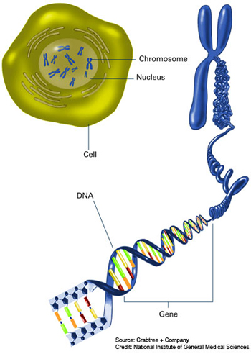
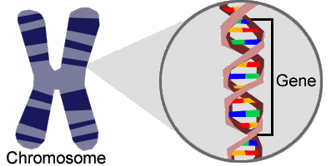
Genes, Chromosomes and DNA
http://learn.genetics.utah.edu/content/chromosomes/intro/

Slide 29
Genes
Genes
Chromosomes
Each set of Genes codes for a different trait

Slide 30
Animations
http://www.yourgenome.org/landing_dgg.shtml
http://learn.genetics.utah.edu/content/molecules/gene/

Slide 31
Study Jams: Heredity
http://studyjams.scholastic.com/studyjams/jams/science/human-body/heredity.htm
[introduces dominant and recessive]

Slide 32
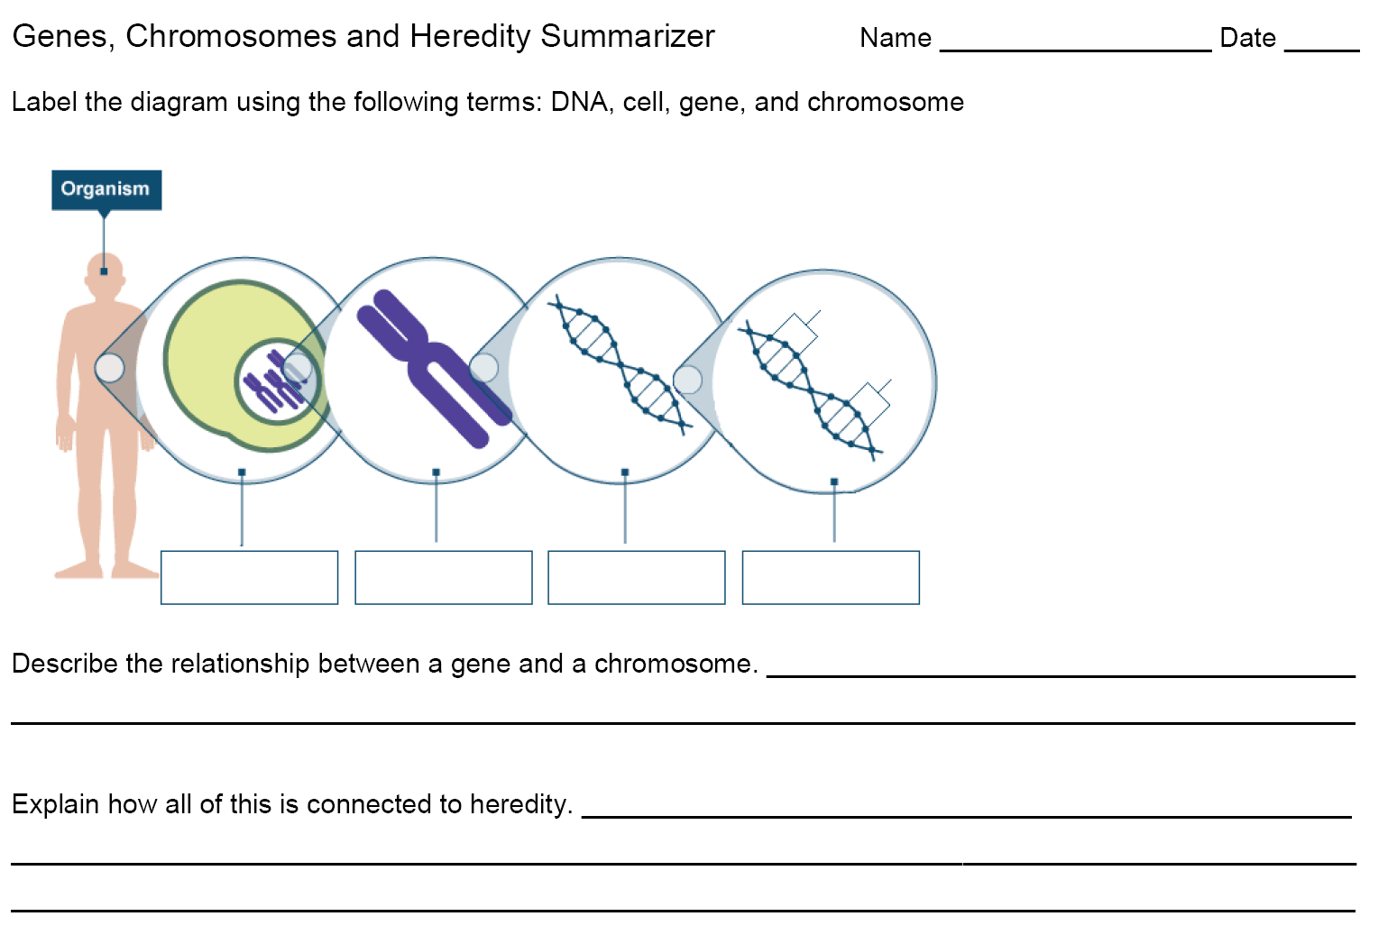
Summarizing Strategy:

