Slide 1
Human Body Systems Group #2 - Energy
The Respiratory System
The Digestive System system
The Cardiovascular System (Skin)

Slide 2
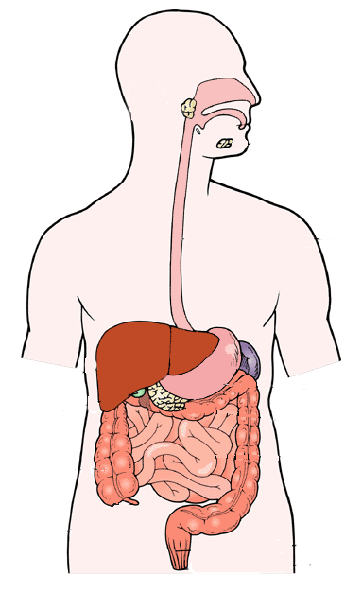
The Digestive System - Functions
Provides nutrients to the body
Nutrients are digested and used in cellular respiration to give the body energy (ATP)

Slide 3
The Digestive System - Structures
Cells & Tissues - epithelial and smooth muscle tissue
Organs
Esophagus – swallowing tube
Stomach – digests food
Liver – filters toxins
Pancreas – produce insulin to digest sugar
Intestines
nutrients absorbed into bloodstream
wastes removed

Slide 4
The Digestive System - Interactions
Skeletal
teeth used in chewing
bones protect internal organs
Muscular
muscles help to push food through the digestive tract
muscles help digest food by grinding (teeth, stomach)
Cardiovascular - the heart pumps the blood that contains the digested food

Slide 5
The Digestive System - Interactions
Respiratory - the food received from digestion combines with the oxygen received from the lungs during cellular respiration to produce energy for the body (ATP)
Excretory – wastes (feces) are removed at the end of the large intestine
Nervous & Senses
nervous system triggers hunger and controls digestion
senses aid in identifying food
Endocrine – glands release hormones that aid digestion (example: the pancreas releases insulin to help digest sugar)

Slide 6
The Respiratory System - Functions
Provides oxygen for the body
Removes wastes from the body
Provides voice

Slide 7
The Respiratory System - Structures
Cells – epithelial & smooth muscle cells
Tissue – epithelial & smooth muscle tissue
Organs
lungs – collect and release gases
diaphragm – largest muscle in the human body
alveoli – tiny air sacs in the lungs that exchange gases with the blood vessels by diffusion

Slide 8
The Respiratory System - Interactions
Skeletal – lungs are protected by the rib cage
Muscular
diaphragm expands and contracts causing the lungs to expand and deflate (inhaling and exhaling)
Nervous & Senses
nervous system controls breathing rate - you have both conscious (voluntary) control and subconscious (involuntary control)
controls vocal cords (larynx)

Slide 9
The Respiratory System - Interactions
Cardiovascular
the heart pumps the blood that contains the gases traveling to the body from the lungs or from the body back to the lung
oxygen (O₂)in and carbon dioxide (CO₂) out
Digestive
the oxygen received from the lungs combines with digested food during cellular respiration to produce energy for the body (ATP)
Excretory
exhaling removes carbon dioxide (CO₂), water, and heat from the body

Slide 10
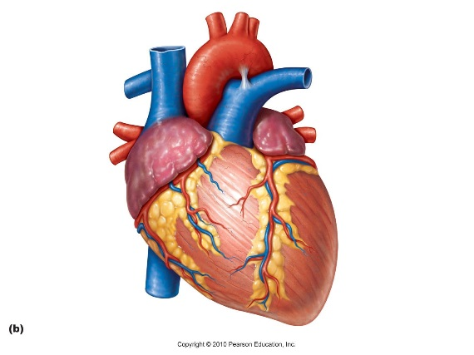
The Cardiovascular System – Functions
Also called the circulatory system
Provides circulation of nutrients (oxygen, digested food, water) and wastes (carbon dioxide)

Slide 11
The Cardiovascular System – Structures
Cells
red blood cells carry oxygen (O₂) throughout body
red blood cells carry carbon dioxide (CO₂) back to the lungs for removal
white blood cells fight pathogens such as bacteria and viruses
Tissues – cardiac muscle tissue
Organs – heart, blood vessels

Slide 12
The Cardiovascular System – Interactions
Skeletal
the heart is protected by the rib cage
red blood cells are produced in the marrow of long bones
Muscular – the heart is made of muscle tissue that pumps about 5 liters of blood throughout the body constantly
Respiratory
circulates oxygen (O₂) from the lung to the body
Circulates carbon dioxide (CO₂) from the body back to the lungs
Digestion – circulates digest nutrients to all body cells

Slide 13
The Cardiovascular System – Interactions
Excretory
transports carbon dioxide (CO₂) back to the lungs for exhaling
transports blood to kidneys for filtering
Immune – transports white blood cells to fight pathogens such as bacteria and viruses throughout the body
Nervous & Senses – heartbeat controlled involuntarily by subconscious nervous system

