Slide 1
Passive Transport:
Go with the Flow

Slide 2
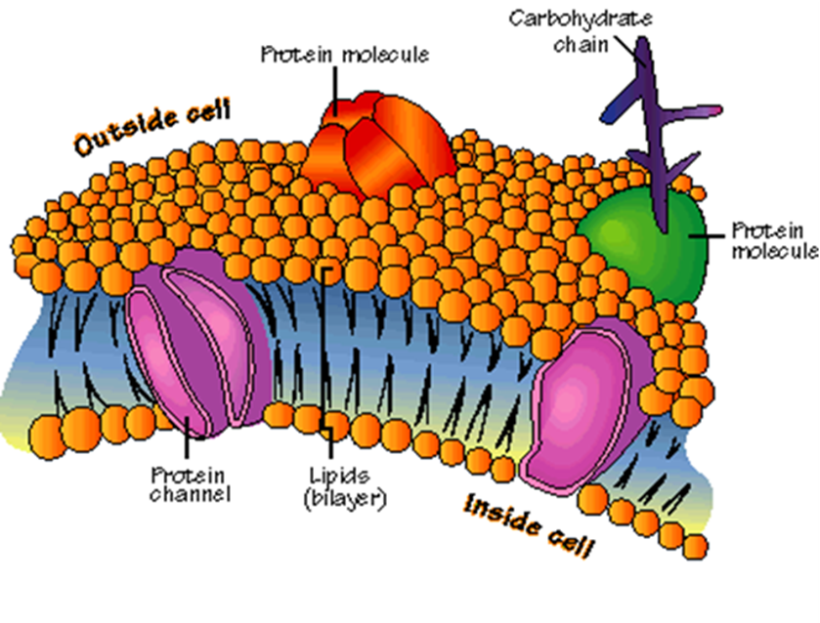
Cells Live in a Liquid Environment
Plasma Membrane
Functions of the plasma membrane:
Gatekeeper
Regulates the movement of dissolved molecules from the liquid on one side of the membrane to the liquid on the other side.
Main components:
Proteins
Lipids in a bilayer
Carbohydrates

Slide 3
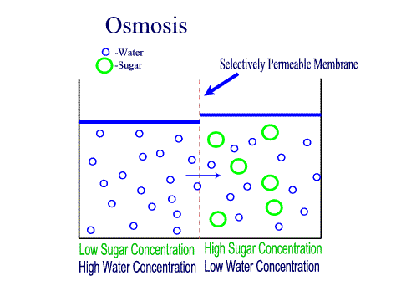
Solution: Mixture of substances so molecules are evenly distributed.
Source: http://people.eku.edu/ritchisong/RITCHISO/osmosis3.gif
Concentration is the mass of solute in a given volume of solution.
Example: 4 grams per Liter is four times more concentrated than 1 gram per Liter

Slide 4
Passive Transport
Process that moves materials across the plasma membrane
Does not require energy from the cell
Materials move with the concentration gradient:
high concentration low concentration
3 Kinds:
Diffusion, Osmosis, and Facilitated Diffusion

Slide 5
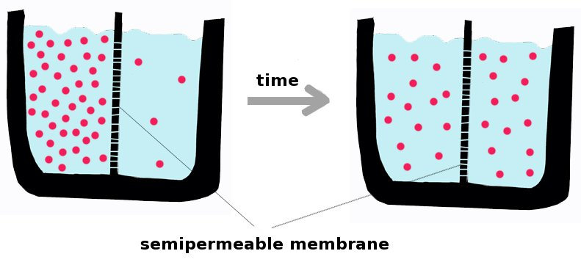
Diffusion
The movement of molecules across a membrane, with a net movement from high to low concentration
Molecules tend to “spread out” to reach equilibrium.
Source: http://upload.wikimedia.org/wikipedia/commons/1/15/Diffusion.en.jpg

Slide 6
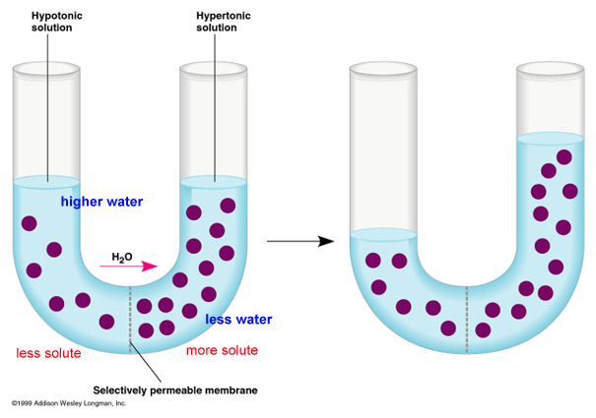
Osmosis
Diffusion of water across a selectively permeable membrane.
Does not require energy from the cell.

Slide 7
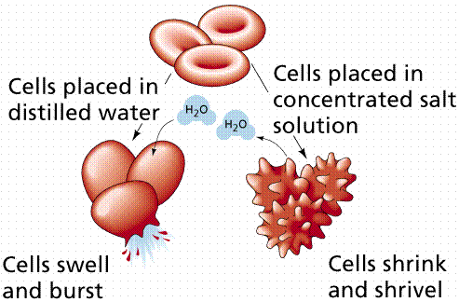
The rule for osmosis: If the area outside the cell has more salt, then water will be sucked out of the cell.

Slide 8
Passive Transport: Review
Diffusion, Osmosis, Facilitated Diffusion
Molecules move with the concentration gradient
Does not require energy from the cell

Slide 9
Active Transport:
Energy Required

Slide 10
Active Transport
Process that moves materials across the plasma membrane
Requires energy from the cell in the form of ATP
Materials move against the concentration gradient:
low concentration high concentration
3 Kinds:
Pumps, Endocytosis, and Exocytosis

Slide 11
Endocytosis
When a cell actively takes large molecules into itself by folding the plasma membrane inward, forming a vesicle
Source: http://kenpitts.net/bio/images/endocytosis.gif

Slide 12
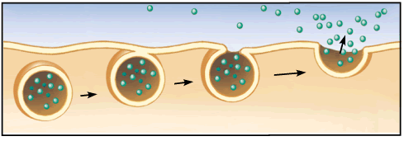
Exocytosis
When a cell actively releases large molecules by folding the plasma membrane outward, forming a vesicle
Source: http://kenpitts.net/bio/images/exocytosis.gif

Slide 13
Active Transport: Review
Pumps, Endocytosis, Exocytosis
Molecules move against the concentration gradient
Requires energy from the cell (ATP)

Slide 15
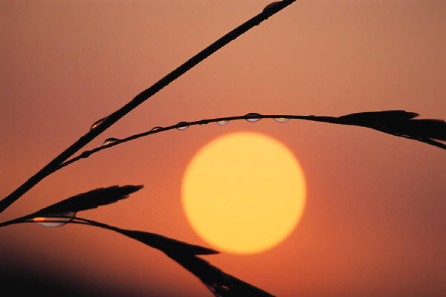
PHOTOSYNTHESIS
Process: Plants and plant-like organisms make their energy (glucose) from sunlight.
Stored as carbohydrate in their bodies.
6CO₂ + 6H₂O + sunlight → C₆H₁₂O₆ + 6O₂

Slide 16
Why is Photosynthesis important?
Makes organic molecules (glucose) out of inorganic materials (carbon dioxide and water).
It begins all food chains/webs. Thus all life is supported by this process.
It also makes oxygen gas!!

Slide 17
Photo-synthesis
means "putting together with light."
Plants use sunlight to turn water and carbon dioxide into glucose. Glucose is a kind of sugar.
Plants use glucose as food for energy and as a building block for growing.
Autotrophs make glucose and heterotrophs are consumers of it.

Slide 18
Photosynthesis
Carbon dioxide + water glucose + oxygen
sunlight
absorbed by chlorophyll
6CO₂ + 6H₂O + energy → C₆H₁₂O₆ + 6O₂
As can be seen from the equation for photosynthesis, the wood, bark, and root came from water and carbon dioxide.

Slide 19
Plants in Action
Check it!
What is the process that uses the sun’s energy to make simple sugars?

Slide 20
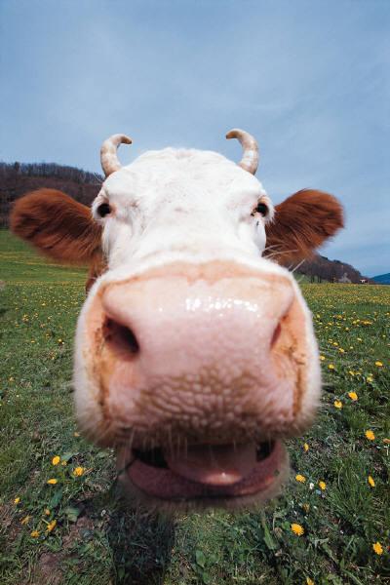
PHOTOSYNTHESIS AND CELLULAR RESPIRATION
We will examine the exchange of oxygen and carbon dioxide between living things and the environment.

Slide 21
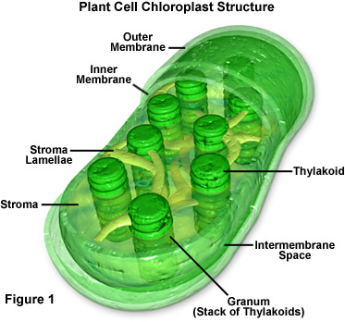
Key Elements
Chloroplasts - Organelles found only in plant cells that carry out photosynthesis.
Mitochondria - Organelles found in plant and animal cells that carry out cellular respiration.

Slide 22
EQUATION FOR PHOTOSYNTHESIS
Reactants
Products
WATER
OXYGEN
6CO₂ +
6H₂O +
ENERGY
produces
C₆H₁₂O₆ +
6O₂
CARBON DIOXIDE
GLUCOSE

Slide 23
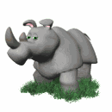
EQUATION FOR RESPIRATION
Reactants
Products
CARBON DIOXIDE
GLUCOSE
ATP
C₆H₁₂O₆ +
6O₂
produces
6CO₂ +
6H₂O +
ENERGY
OXYGEN
WATER

Slide 24
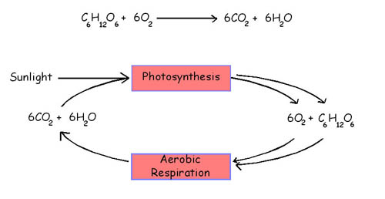
HOW IT RELATES!

Slide 25
Overview of photosynthesis and respiration
SUN
RADIANT ENERGY
CELL
ACTIVITIES
PHOTOSYNTHESIS
RESPIRATION
GLUCOSE
ATP(ENERGY)

Slide 26
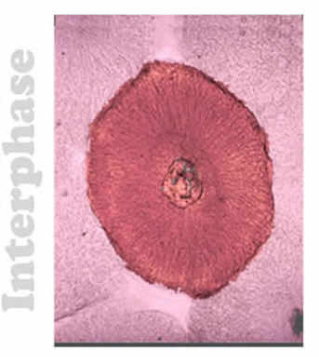
Interphase—period of cell growth and development
DNA replication (copying) occurs during Interphase
During Interphase the cell also grows, carries out normal cell activities, replicates all other organelles
The cell spends most of its life cycle in Interphase

Slide 27
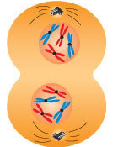
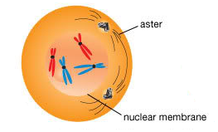
Mitosis – division of the nucleus into 2 nuclei, each with the same number of chromosomes
Mitosis occurs in all the somatic (body) cells
Why does mitosis occur?
So each new daughter cell has nucleus with a complete set of chromosomes

Slide 28
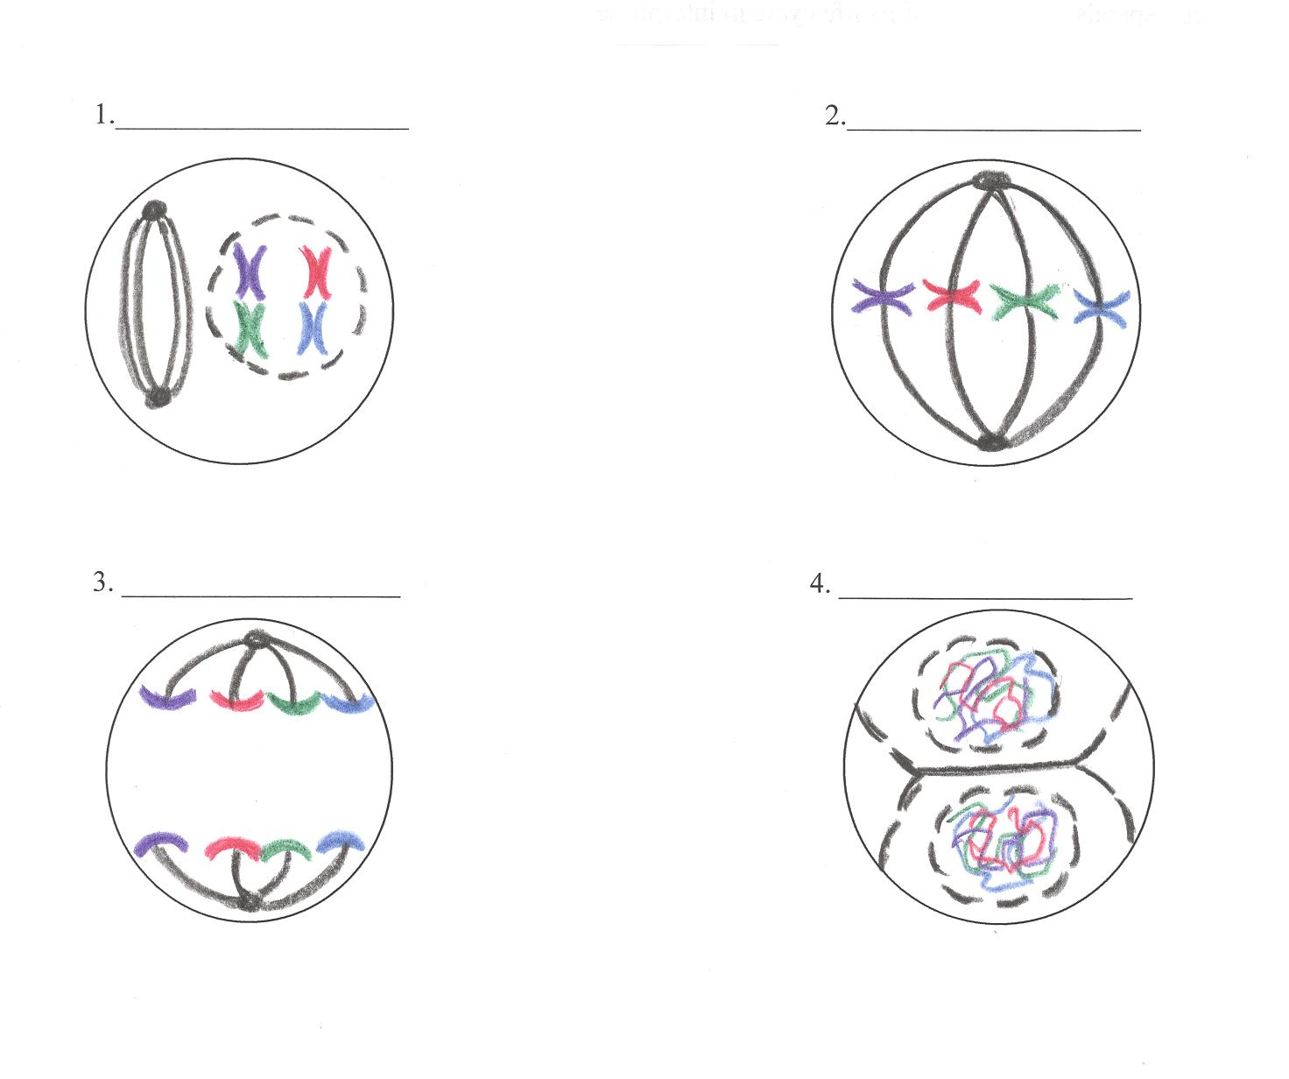
4 phases of nuclear division (mitosis), directed by the cell’s DNA (PMAT)
Prophase
Metaphase—(Middle)
Anaphase—(Apart)
Anaphase—(Apart)
Telophase—(Two)

Slide 29
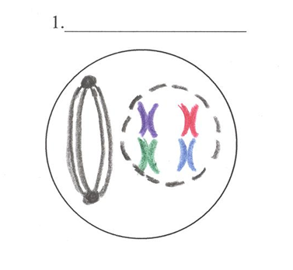
Prophase
Chromosomes coil up
Nuclear envelope disappears
Spindle fibers form

Slide 30
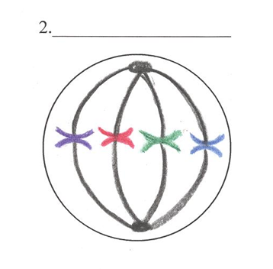
Metaphase—(Middle)
Chromosomes line up in middle of cell
Spindle fibers connect to chromosomes

Slide 31
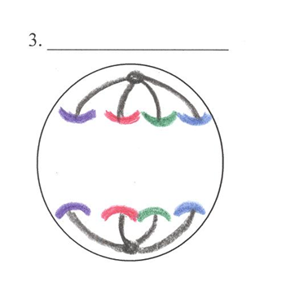
Anaphase—(Apart)
Chromosome copies divide
Spindle fibers pull chromosomes to opposite poles

Slide 32
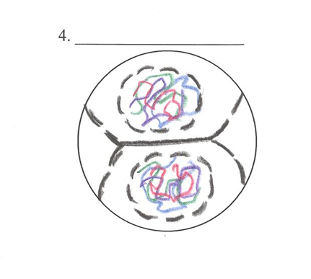
Telophase—(Two)
Chromosomes uncoil
Nuclear envelopes form
2 new nuclei are formed
Spindle fibers disappear

Slide 33
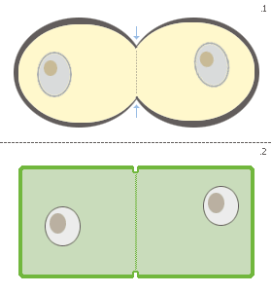
Cytokinesis — the division of the rest of the cell (cytoplasm and organelles) after the nucleus divides
In animal cells the cytoplasm
pinches in
In plant cells a cell plate forms
After mitosis and cytokinesis, the cell returns to Interphase to continue to grow and perform regular cell activities

Slide 34
Summary: Cell Cycle
Interphase Mitosis (PMAT) Cytokinesis
When cells become old or damaged, they die and are replaced with new cells

Slide 35
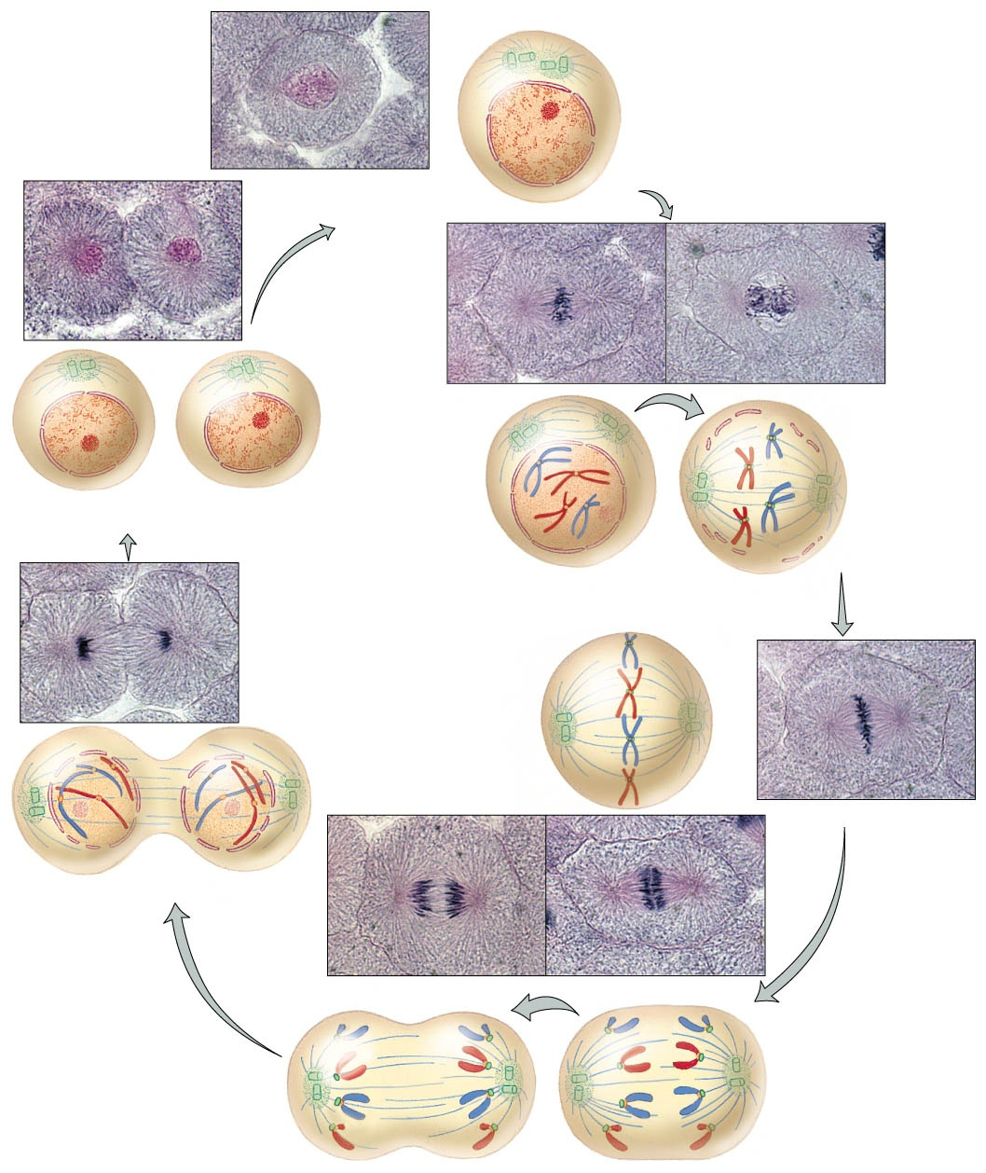

Slide 36
Phase | Chromosome Appearance & Location | Important Events
Interphase
Prophase
Metaphase
Anaphase
Telophase
Cytokinesis
DNA replication, cell grows and replicates organelles
DNA copies itself; chromatin
Nuclear envelope disappears, spindle fibers form
Chromosomes coil up
Chromosomes line up in the middle
Spindle fibers connect to chromosomes
Chromosome copies divide and move apart
Spindle fibers pull chromosome copies apart to opposite poles
Nuclear envelopes reform, 2 new nuclei are formed, spindle fibers disappear
Chromosomes uncoil back into chromatin
Division of the rest of the cell: cytoplasm and organelles
Chromatin

